Slide 1

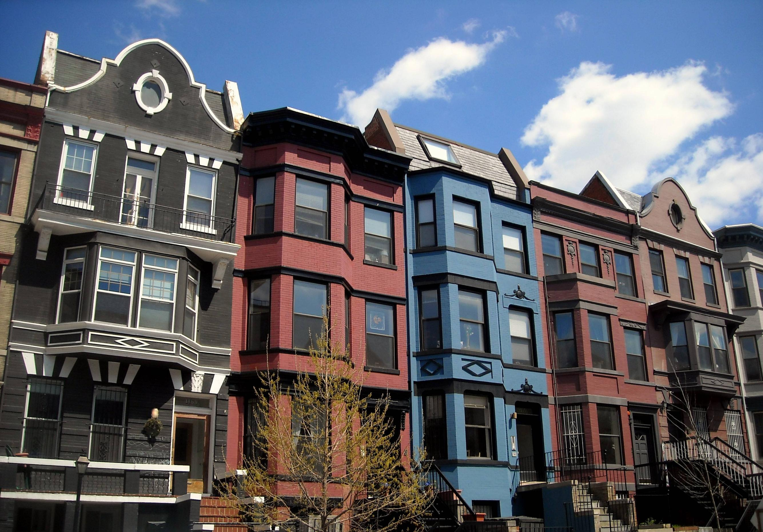
House Price Prediction
Prabhakar kumar jha
This Photo by Unknown Author is licensed under CC BY-SA

Slide 2
Introduction
Problems faced during buying a house:
1) Buying a house is a stressful thing.
2) Buyers are generally not aware of factors that influence the house prices.
3) Many problems are faced during buying a house.
4) Hence real estate agents are trusted with the communication between buyers and sellers as well as laying down a legal contract for the transfer. This just creates a middle man and increases the cost of houses

Slide 3
Depending Factors
They believe that it depends upon:
1) The square foot area
2) Neighbourhood
3) The no. of bedrooms
But it depends upon many factors also…..Such as:
1) No. of storeys.
2) Area outside the house.
3) Rooms on one floor.

Slide 4
Problem Statement
Houses are one of the necessary need of each and every person around the globe and therefore housing and real estate market is one of the markets which is one of the major contributors in the world’s economy. It is a very large market and there are various companies working in the domain. Data science comes as a very important tool to solve problems in the domain to help the companies increase their overall revenue, profits, improving their marketing strategies and focusing on changing trends in house sales and purchases. Predictive modelling, Market mix modelling, recommendation systems are some of the machine learning techniques used for achieving the business goals for housing companies. Our problem is related to one such housing company.
Objective: To build a model to predict the house prices for a US based company named Surprise Housing.

Slide 5
Flow Chart
Data Reading
Data Wrangling
Exploratory Data Analysis
Feature Selection
Data Cleaning
Prediction/
Conclusion
Cross Validation Score
Model Building
Hyper Parameter Tuning

Slide 6
Data Reading
Training Dataset: The preparation information comprises of 1,168 instances of houses with 81 highlights portraying each part of the house. We are given sale prices (labels) for each house. The preparation information is what we will use to "instruct" our models.
Testing Dataset: The test informational collection comprises of 292 models with similar number of highlights as the preparation information. Our test informational collection prohibits the deal cost since this is the thing we are attempting to anticipate. When our models have been constructed we will run the best one on the test dataset.

Slide 7
Data Cleaning
Generally speaking, machine learning projects follow the same process. Data ingestion, data cleaning, exploratory data analysis, feature engineering and finally machine learning. I started by removing duplicates from the data, checked for missing or NaN values. It’s important to check for NaNs.
There are a lot of categorical variables that are marked as N/A when a feature of the house is nonexistent. I identified all the cases where this was happening across the training and test data and replaced the N/As with something more descriptive. N/As can cause errors with machine learning later down the line so get rid of them.
The data consisted of many null values, outliers and skewness. I have dropped all the features with 60%+ missing values. Removed the outliers for training dataset having zscore more than 4 and treated the skewness of all numerical columns using log transformation and power transformation techniques.

Slide 8
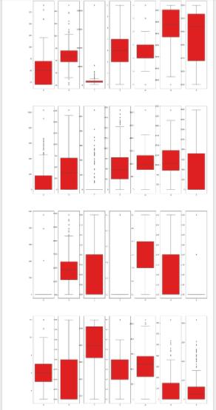
Visualization
1. Box Plot
The box plot gives us the values of Quartiles, Inter Quartile Range and median of the data.
It also tells us about the outliers in that particular feature.

Slide 9
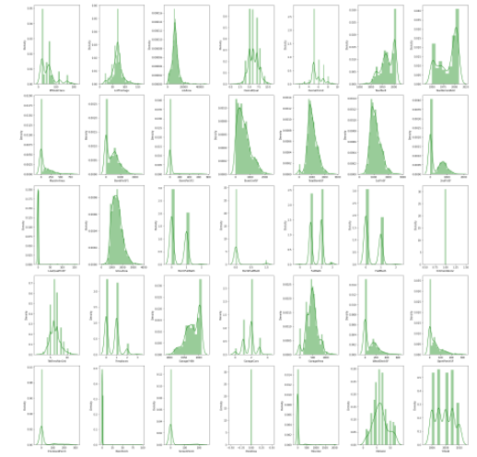
Visualization
2. Distribution Plot
A Distplot or distribution plot, depicts the variation in the data distribution. Seaborn Distplot represents the overall distribution of continuous data variables.

Slide 10
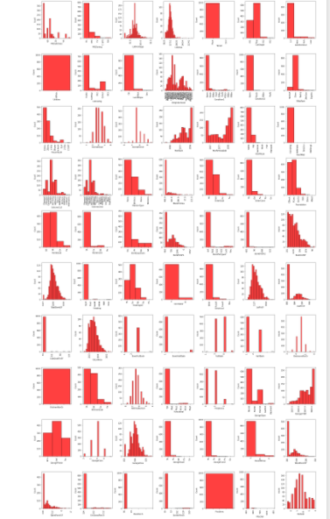
Visualization
3. Histogram
From histogram, We have observed from the above histogram plot that the columns like 'Street', 'Utilities', 'LotContour', 'KitchenAbvGr', '3SsnPorch', 'PoolArea', and 'YrSold' have least contribution in the data prediction as they contains of almost only same values in them.

Slide 11
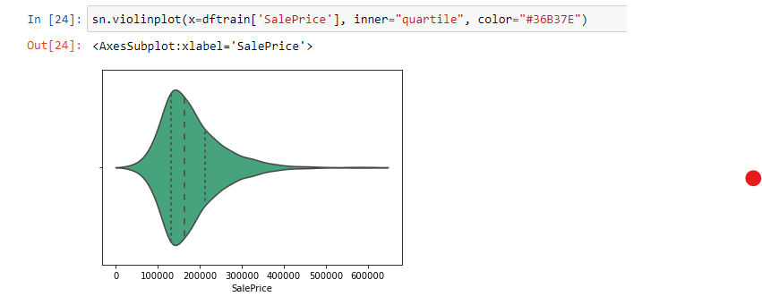
Visualization
4. Violin Plot
Our dataset contains a lot of variables, but the most important one for us to explore is the target variable. We need to understand its distribution. First, we start by plotting the violin plot for the target variable. The width of the violin represents the frequency.
We can see from the plot that most house prices fall between 100,000 and 250,000. The dashed lines represent the locations of the three quartiles Q1, Q2 (the median), and Q3

Slide 12
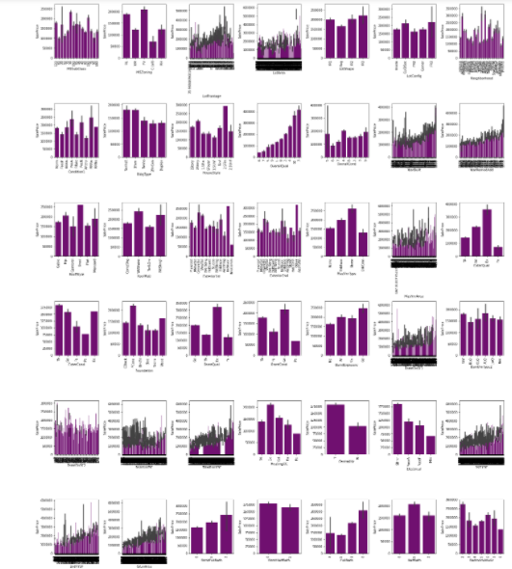
Visualization
5. Bar Plot
There are still so many features and all are affecting the target either in positive way or in negative way. Now let's check out the correlation.
A barplot shows the relationship between a numeric and a categoric variable. Each entity of the categoric variable is represented as a bar. The size of the bar represents its numeric value.

Slide 13
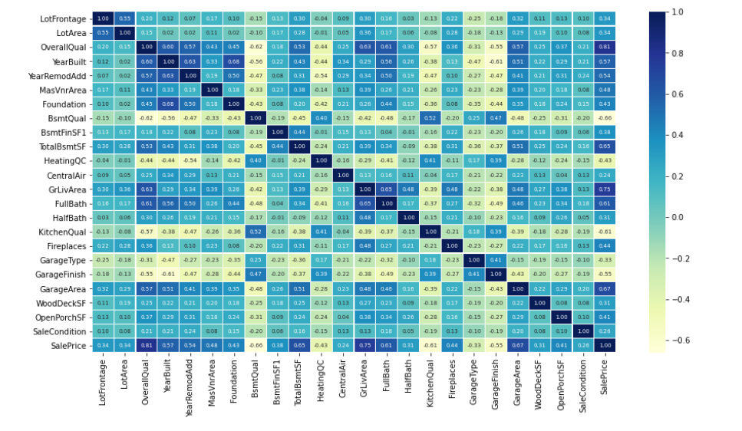
EDA
6. Heat Map
Heatmap gives the
correlation between
features - target &
feature-feature

Slide 14
Model Building
I have used Following algorithms :
i) Linear Regression
ii) Ridge
iii) Elastic Net
iv) SGD Regressor
v) K Neighbours Regressor
vi) Decision Tree Regressor
vii) Random Forest Regressor
viii) Gradient Boosting Regressor

Slide 15
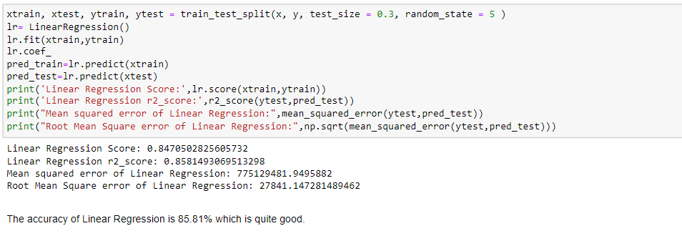
1. Linear Regression

Slide 16
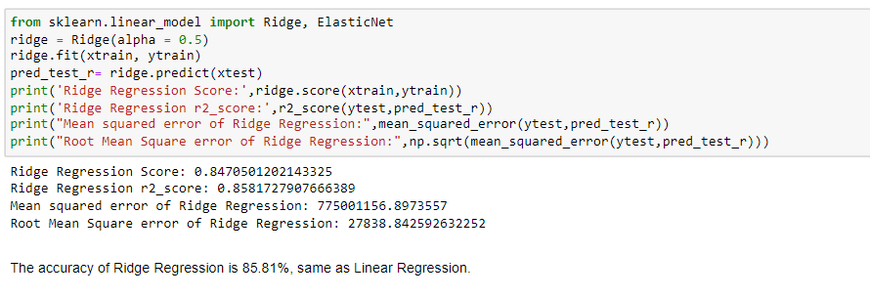
2. Ridge Regression

Slide 17
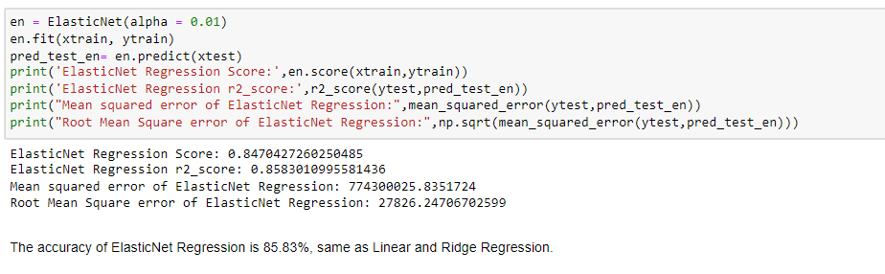
3. Elastic Net

Slide 18
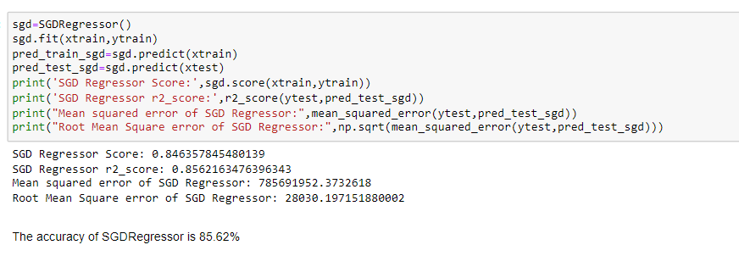
4. SGD Regressor

Slide 19
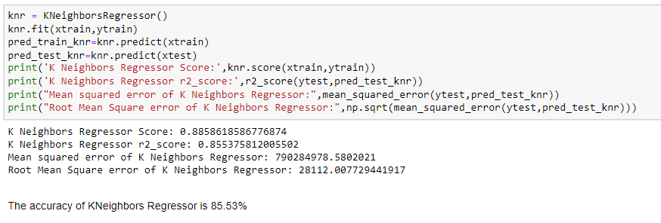
5. K Neighbors Regressor

Slide 20
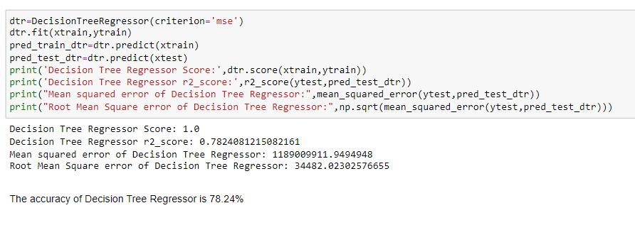
6. Decision Tree Regressor

Slide 21
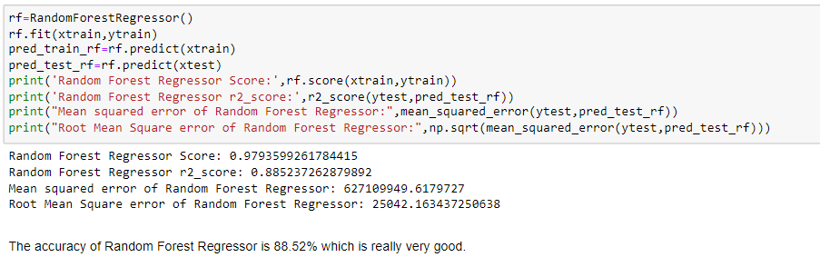
7. Random Forest Regressor

Slide 22
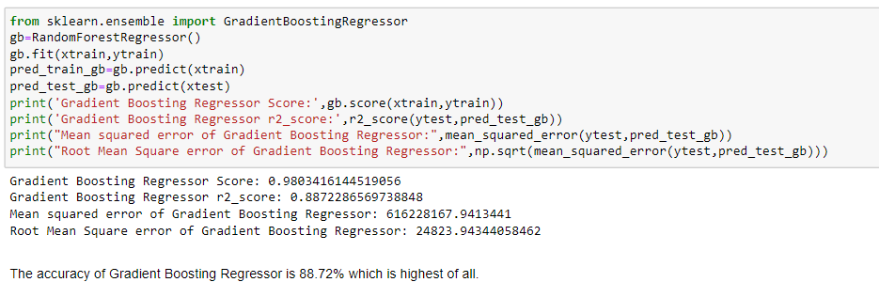
8. Gradient Boosting Regressor

Slide 23
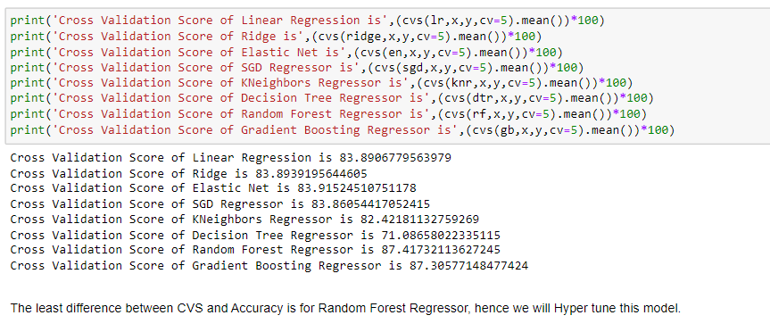
Cross Validation Score

Slide 24
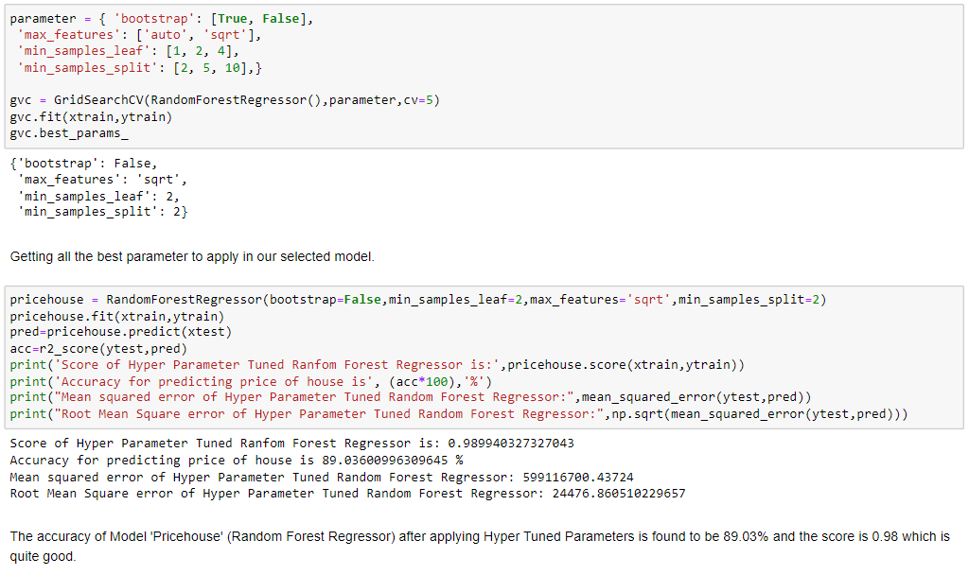
Hyper Parameter Tuning

Slide 25
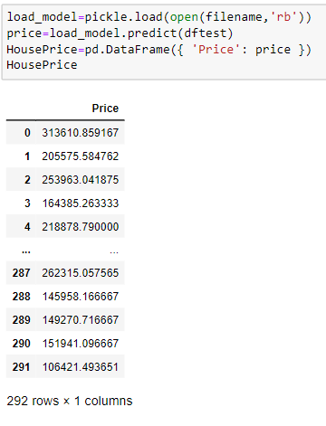
Prediction
Predicting the SalePrice for test dataset using the hyper tuned finalized model.

Slide 26
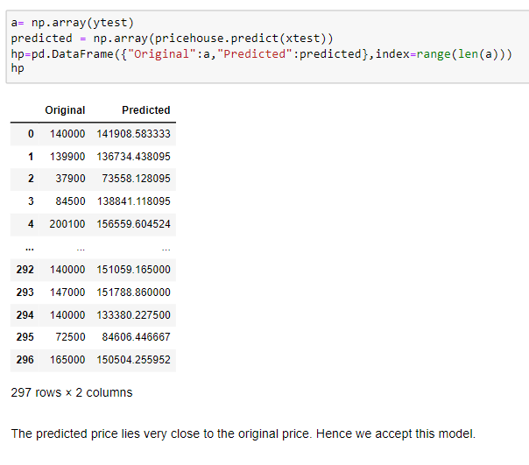
Conclusion
We have used 8 different algorithms and all are working very fine. The Score of each algorithms is above 0.8 0r 80%. The r2 Score (Accuracy) of each model is 85%+ except for Decision Tree Classifier (It has only 78% accuracy). Coming to the case of choosing best model, Random Forest Regressor turned out to be the one being most accurate compared from others followed by Gradient Boosting Regressor. The accuracy of Random Forest is 89% with a score of 0.98 which can be used to solve real world problems easily.

Slide 27
Thank You

